Slide 1
WELCOME
to
Ward Preschool Open House
Our philosophy is “Learning Through Play.”
Ward Preschool was established to provide children a
Christ-centered foundation for the development
of a positive self-image; socialization skills,
basic moral and spiritual concepts, and educational
readiness skills; all to be nurtured
in an atmosphere of Christian love.
Ward Preschool admits students of any race, color, national and ethnic origin to all the rights, privileges, programs and activities generally accorded or made available to students at the school.
It does not discriminate on the basis of race, color, national and ethnic origin in the administration of its educational policies, admissions policies, scholarship programs and other school
administered programs.
Notes:
“Scientists have discovered that it takes approximately 400 repetitions to create a new synapse in the brain, unless it is done in play, in which case it only takes 10 – 20 repetitions” Karyn Purvis

Slide 2
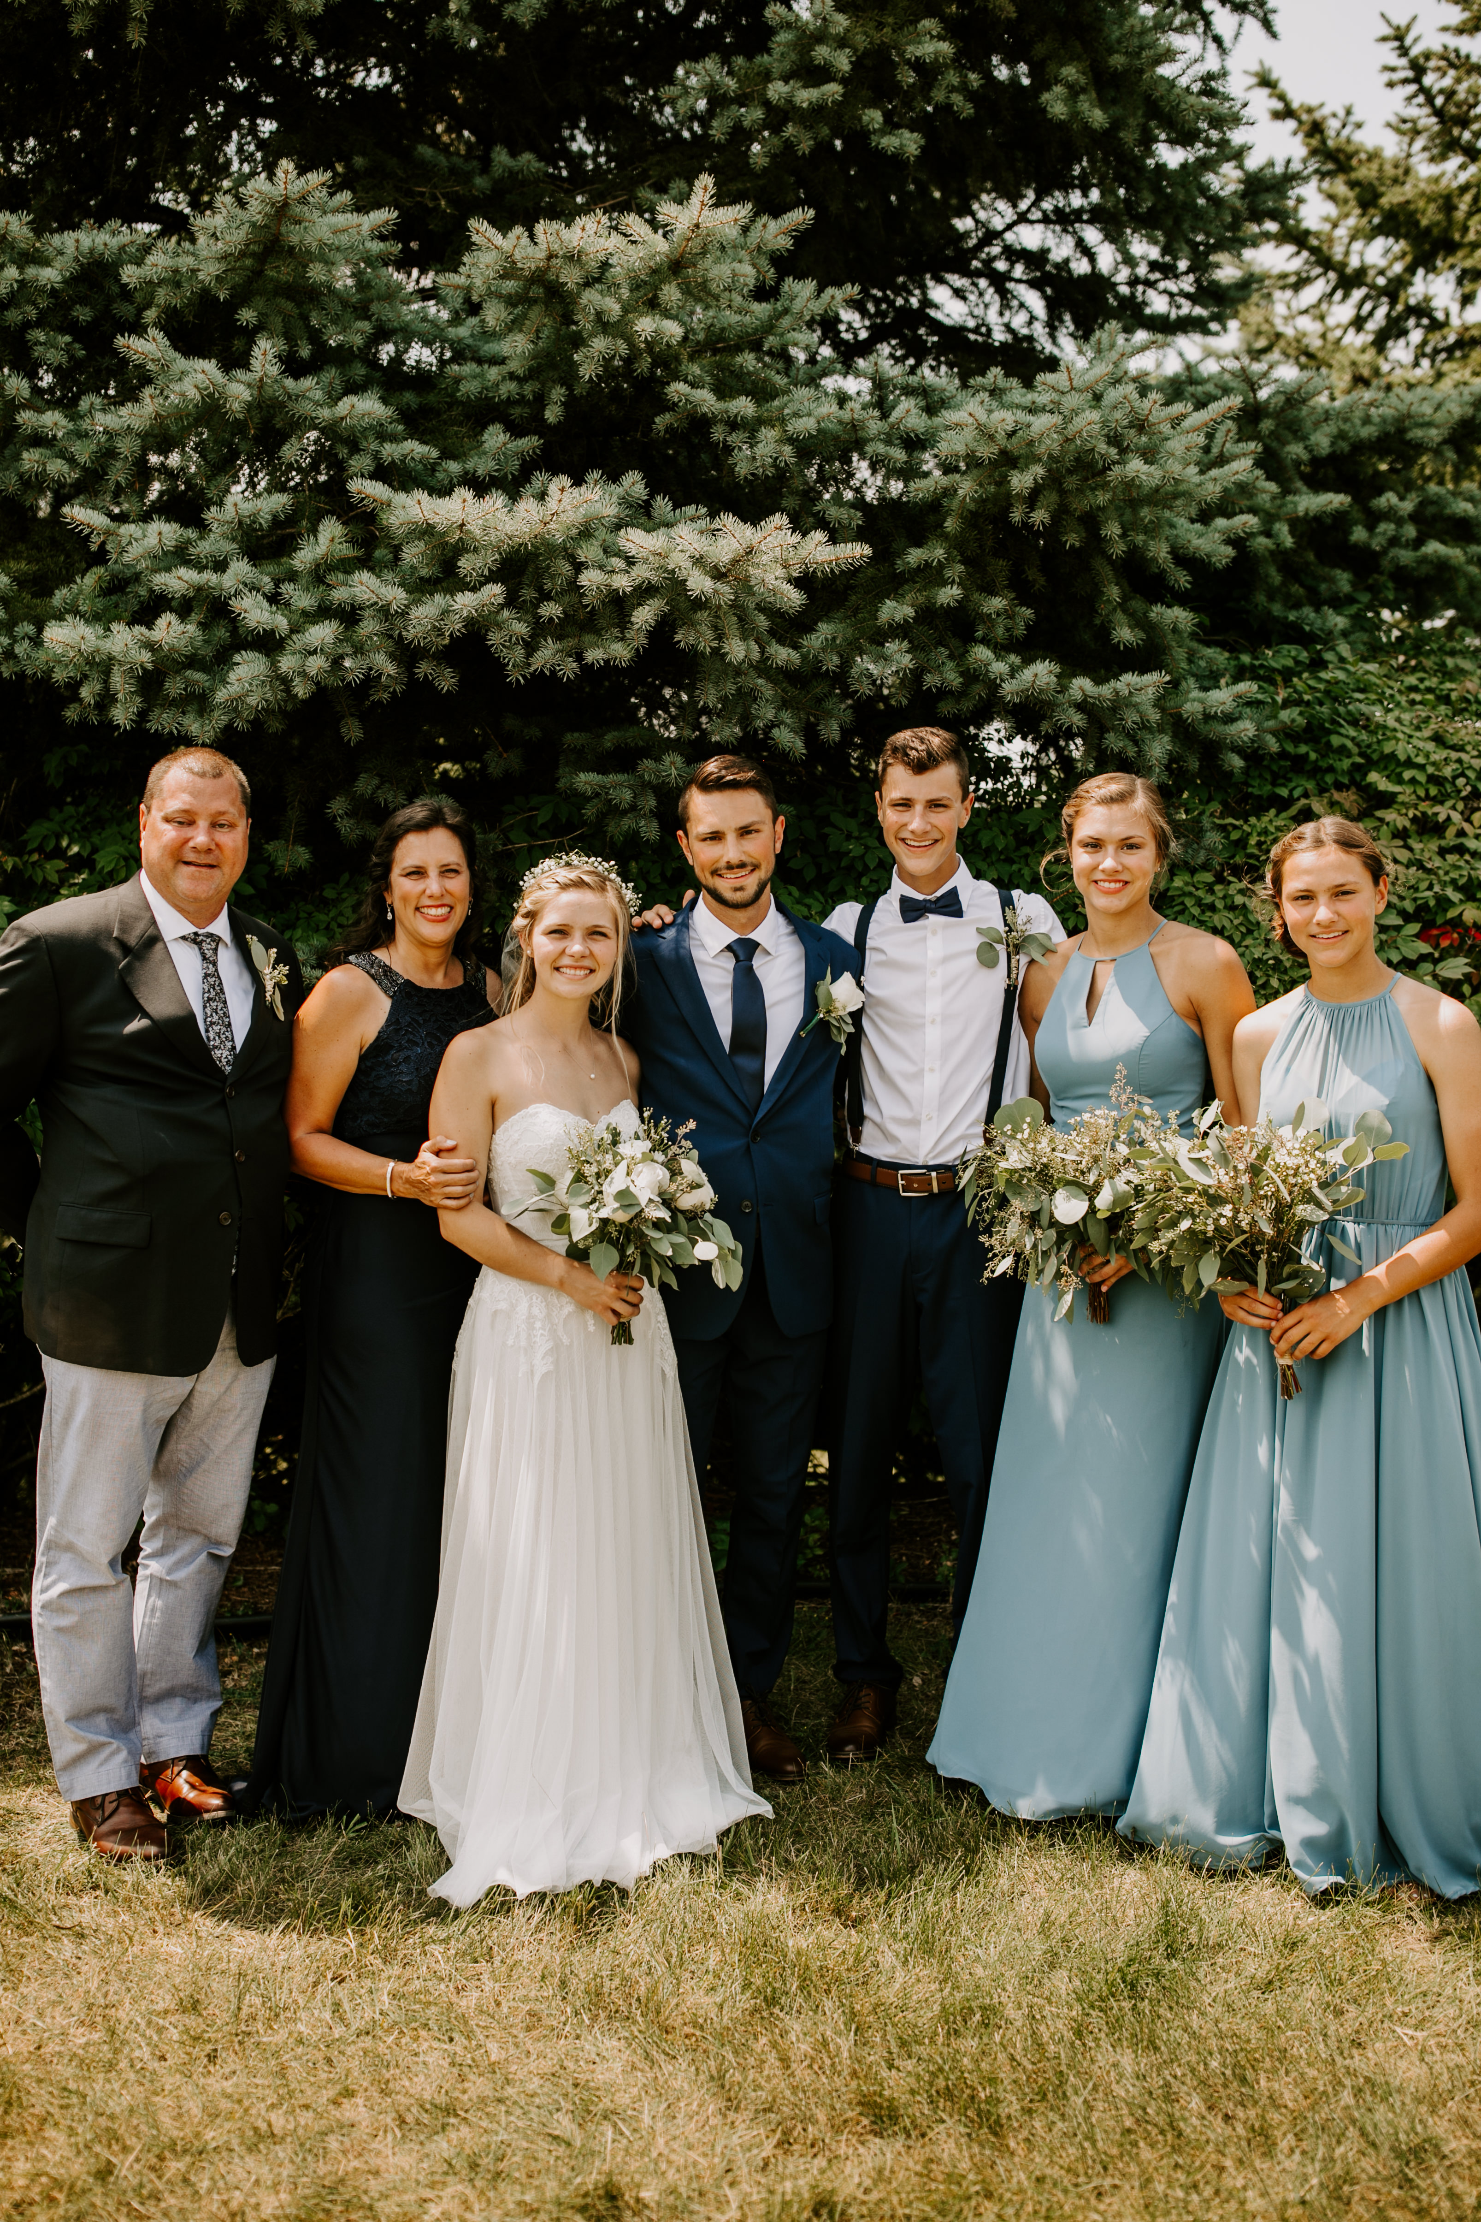
Meet Our
Director
Amy Werthman
Director since Fall 2011
Education: Bachelor of Science in Elem. Ed.
w/ an Early Childhood Endorsement from EMU
Currently Teaches Sunday School
Kids Kamp Summer Director @Ward 2010-2018
Early Childhood Director @Ward 2008-2011
Family
Married to Bill - 30 years
Billy + Samantha
Emma 23 Samuel 21 Abby 19
Notes:
I was a stay-at-home mom for a long time, gaining experience to add to my degree with many opportunities offered here at Ward Church. I was also a big fan of Ward Preschool before I even became the director, all my children attended Ward Preschool! Now they are grown up and I am going to be a grandma this summer!!

Slide 3
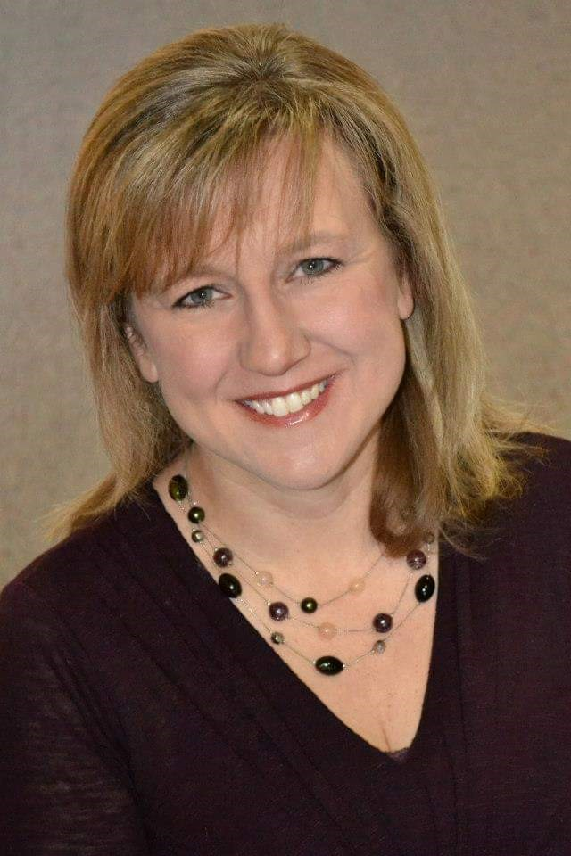
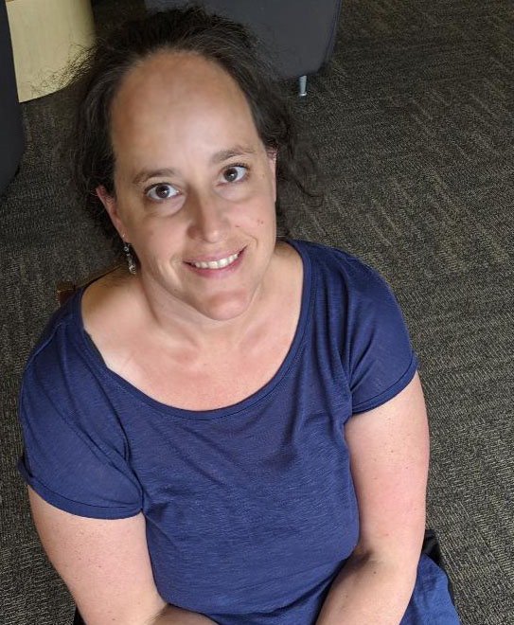
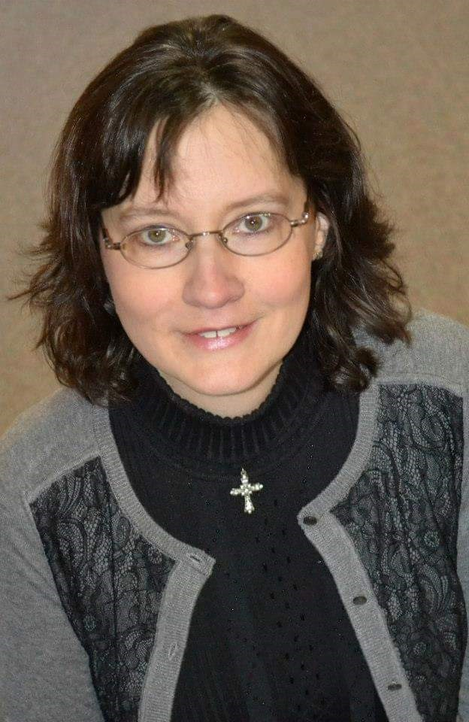
3s Teachers
Meet Our
Three Year
Old Staff
Mrs. McKee
Panda Room
Mrs. Story
Frog Room
3s Assistants
Mrs. Ehlers
Mrs. Putz
Mrs. Lynn
Notes:
I will introduce our three-year-old staff. Can you ladies please raise your hand when I call your names.

Slide 4
Lead Teacher
Assistant
Meet Our
Half Day Four Year
Old Staff
Mrs. Paluk
Mrs. Moore
MONKEY ROOM
Notes:
I will introduce our half day four-year-old staff.

Slide 5
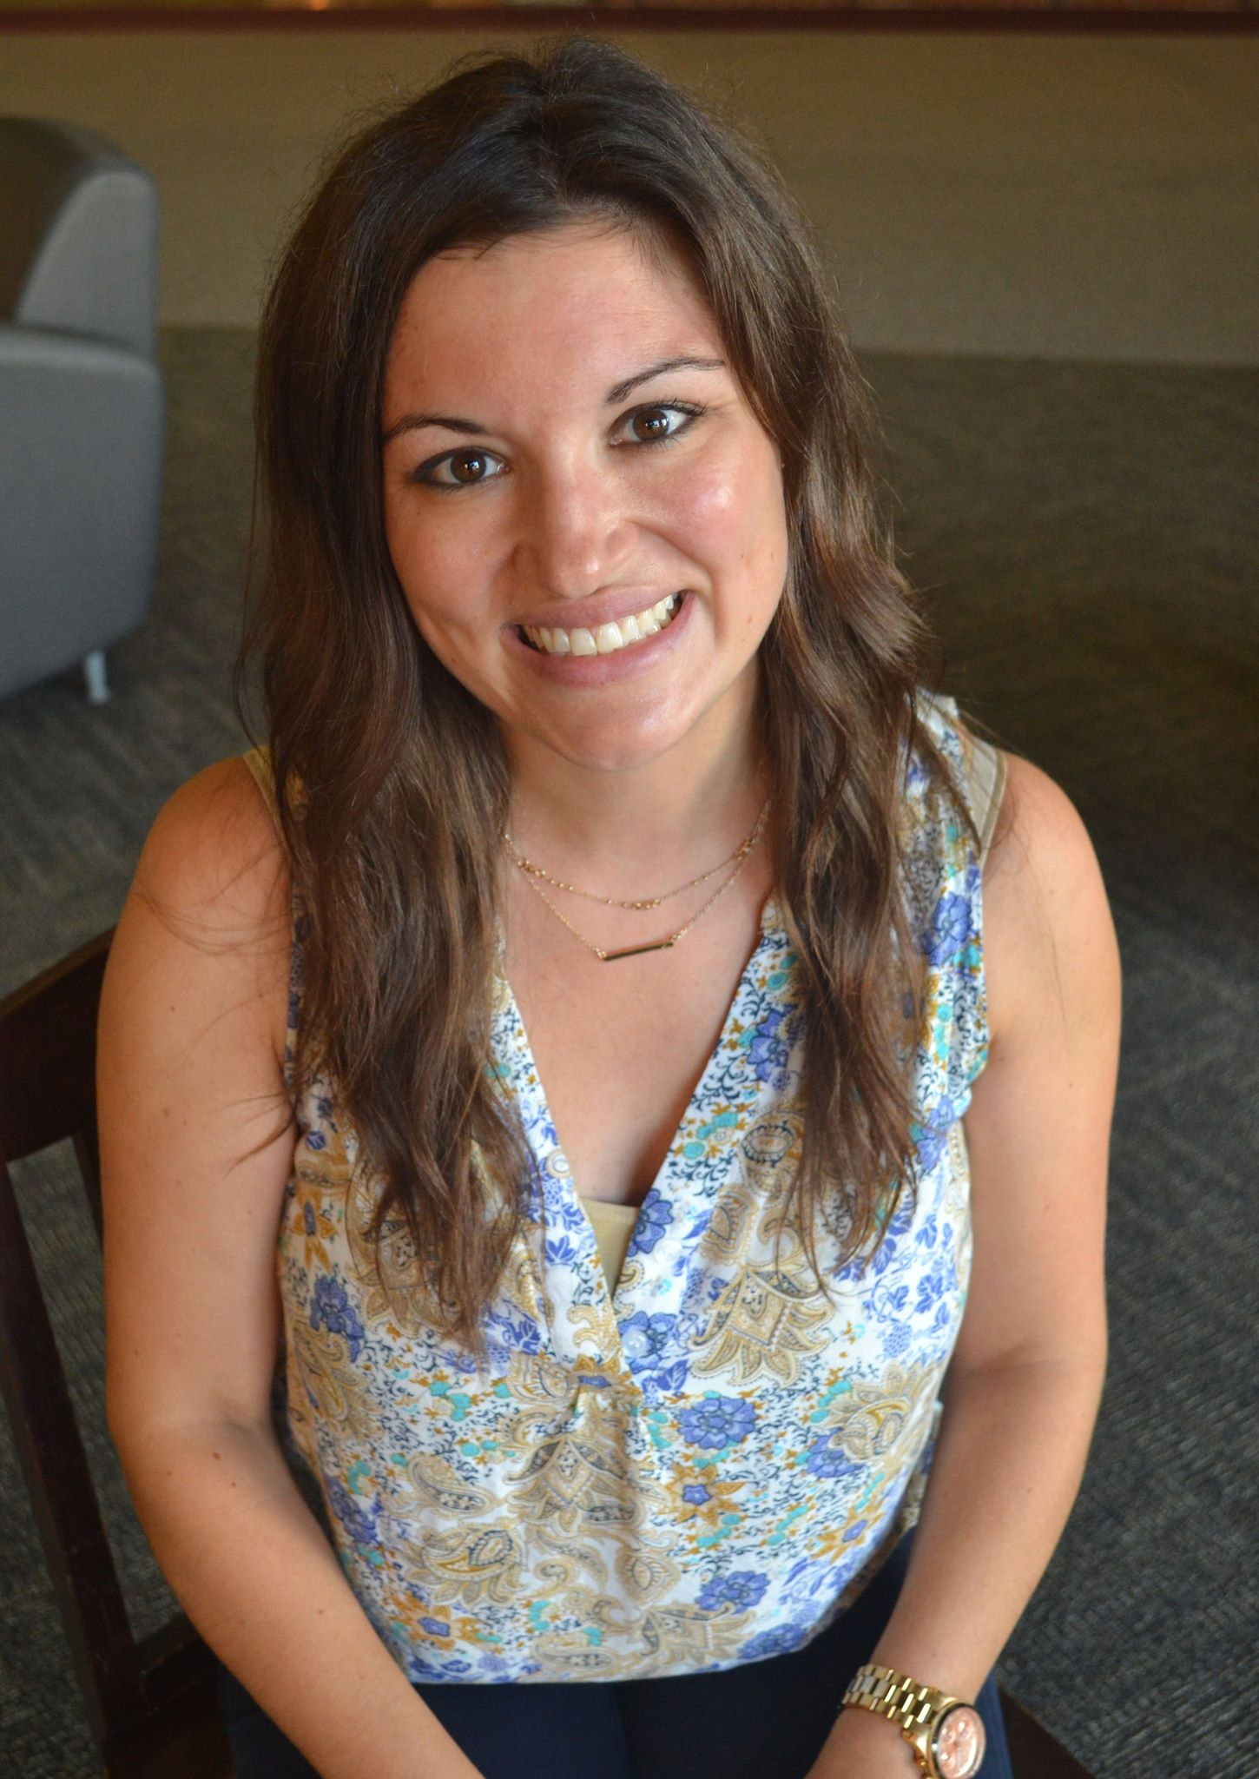
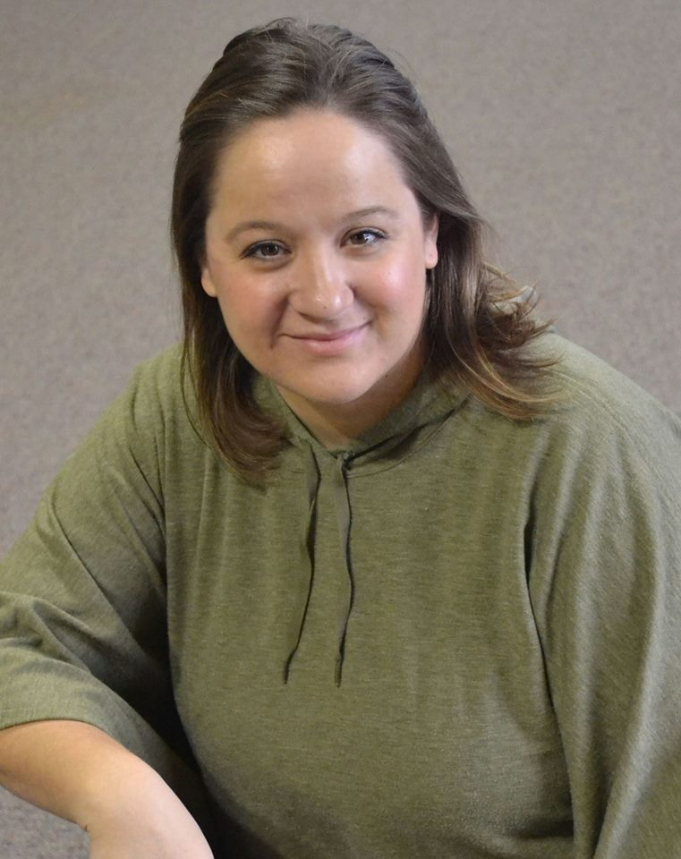
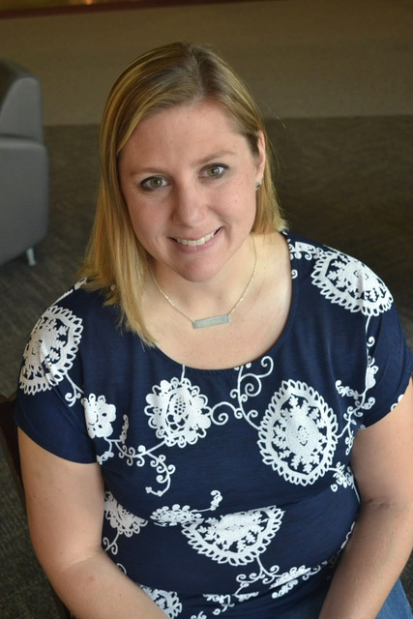
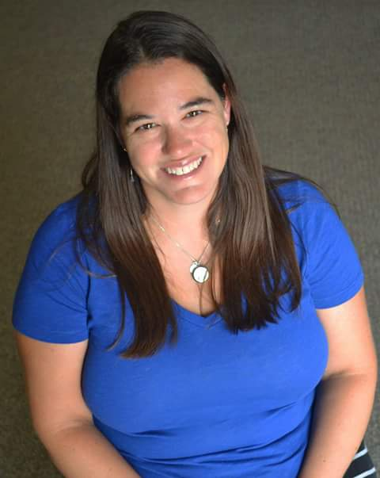
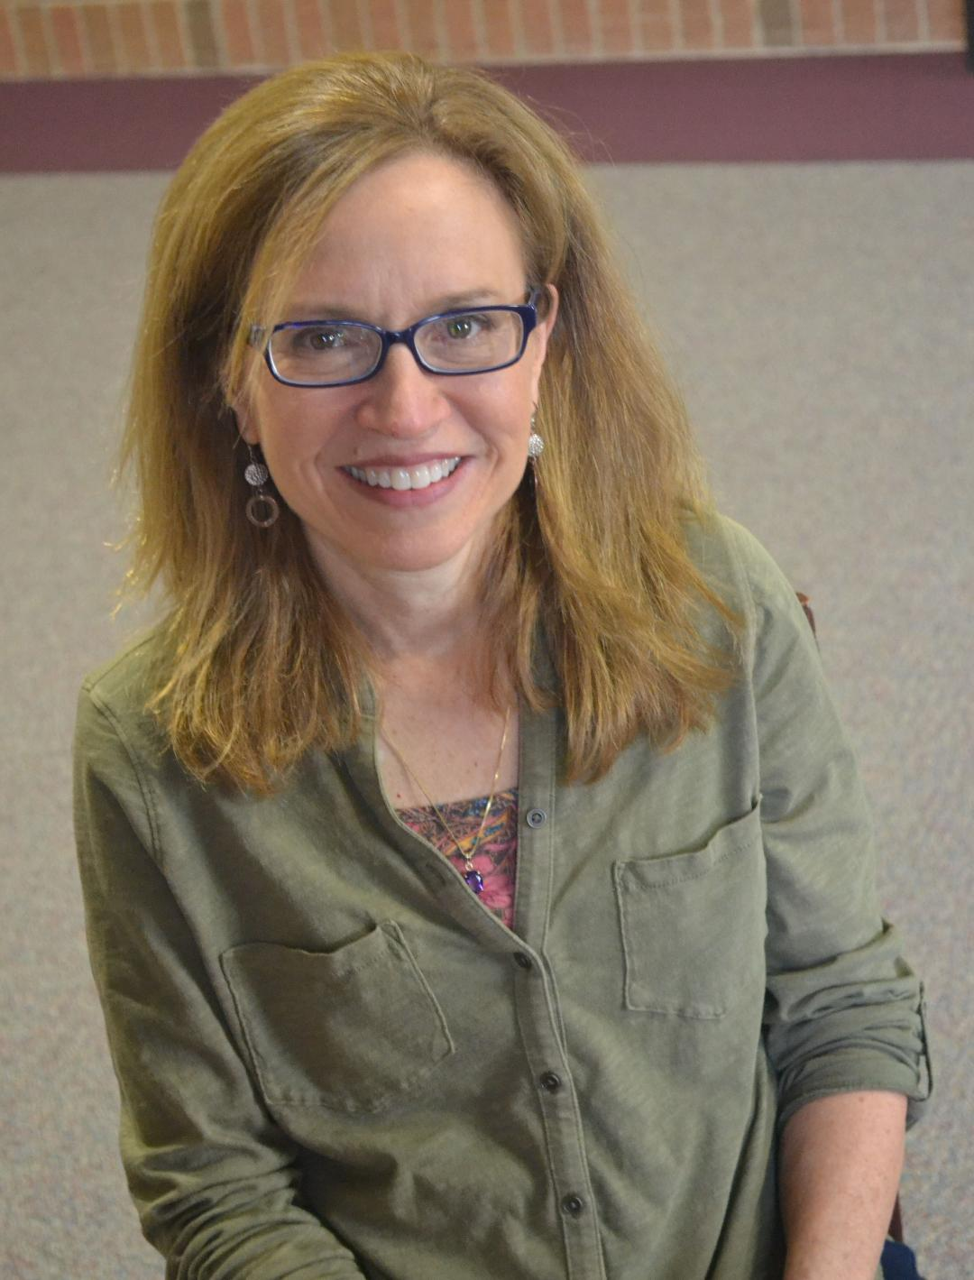
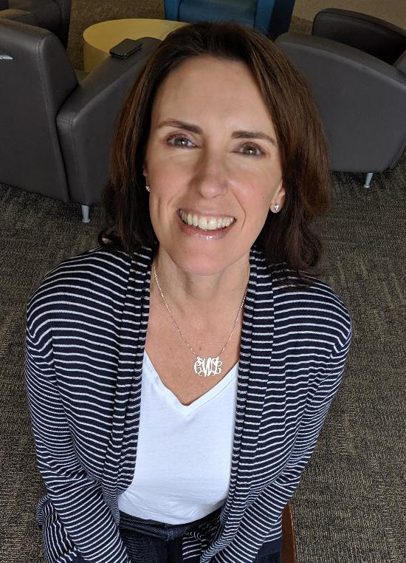
4s Extended Day Teachers
Mrs. Rolfe
Lion Room
Mrs. Sipple
Lion Room
Mrs. Males
Hippo Room
Mrs. Wilson
Hippo Room
Mrs. Mueller
Turtle Room
4s Assistants
Meet Our
Ext. Day Four Year
Old Staff
Ms. Gairdner
Mrs. Walk
Mrs. Picard
Mrs. Waidelich
Notes:
I will introduce our full day -year-old staff.

Slide 6
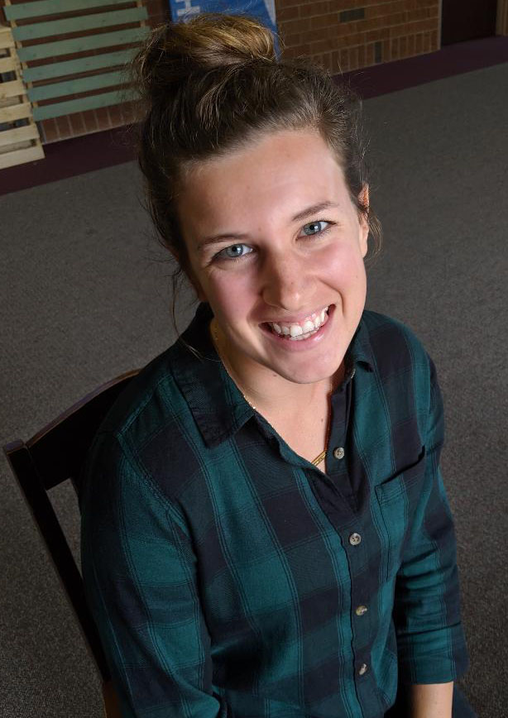
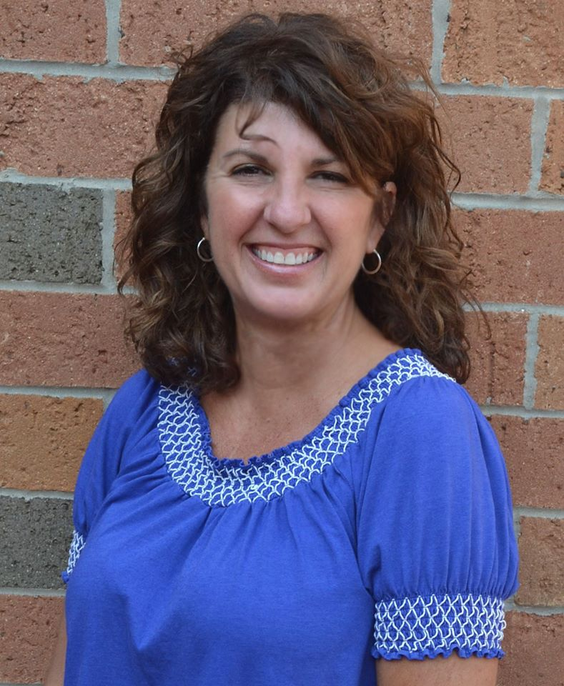
YOUNG FIVES STAFF
Meet Our
Young Fives
Staff
Mrs. Mangeni
Lead Teacher
Mrs. Sliwka
Assistant
RABBIT ROOM – SHINING STARS
Notes:
I will introduce our young fives staff.
Ladies you may all leave, thank you. We will see them in a bit when I dismiss you to the preschool hallway where you can meet them, look at their classrooms and ask them any questions.

Slide 7
Three-Year-Old Preschool
Our goal is for your child to learn to
love school and love learning.
Our play-based program includes colors, shapes, counting, patterning,
using writing tools and scissors, drawing, cooperation & sharing.
We offer many sensory experiences
where we are not afraid to get messy.
We take the first steps to develop
lifelong learners by encouraging creativity, fostering
positive relationships with peers and teachers &
practicing routines and skills needed for school.
Notes:
Goal – Your children to learn to love school and learning.
Play based
Sensory Experiences
Develop Lifelong Learners

Slide 8
3-Year-Old Options
9:00 – 11:30 a.m.
Monday, Wednesday & Friday
or
Tuesday & Thursday
12:30 – 3:00 p.m.
Tuesday & Thursday
Tuition
$144/month for 2 day
$205/month for 3 day
+
Non-Refundable Registration Fee $105
Child Must be Three By September 1, 2022
Child must be fully potty-trained

Slide 9
Four-Year-Old Half Day
$205/month
+
Non-Refundable Registration Fee $105
9:00 – 11:30 a.m.
Tuesday, Wednesday & Thursday
12:30 – 3:00 p.m.
Tuesday, Wednesday & Thursday
Child Must Be Four by September 1, 2022

Slide 10
Center Choice Time
Blocks, dramatic play, toys & games, art, literacy, science & discovery, math, sand & water, writing and journals
Clean Up
Everyone helps to clean up and completes their job of the week
Circle Time
Introduction of letters and letter sounds, Bible verse, Spunky Monkey adventures, weather reports, show & tell, storybook reading, interactive activities, patterning, rote counting & science experiments
Snack Time
Prayer & hand washing occur before eating; snack provided;
Music & Movement
Musical instruments, scarves, rhythm sticks and body movements
are used
Gross Motor Development
Gym or playground
Half Day Four-Year-Old Daily Schedule
Notes:
Gross Motor
Choice Time – all with a theme and letter focus each week; children make choices and teachers do small group work with 2 – 3 children on specific tasks;
Clean Up – jobs, working together
Circle Time – songs, stories, science experiments, etc.
Snack – we provide a peanut/tree nut free snack and water
Music & Movement

Slide 11
4-Year-Old Extended Day
9:00 a.m. – 3:00 p.m.
$342/month
Monday & Wednesday Full Day
+
Friday Half Day
$273/month
Tuesday & Thursday
(9:00-11:30 am
$410/month
Tuesday, Wednesday & Thursday
Non-Refundable Registration Fee $105
Child must Be Four by September 1, 2022

Slide 12
Center Choice Time - Blocks, Dramatic play, toys & games, art, literacy, science & discovery, math, sand & water
Morning Circle - Calendar, weather, Bible Verse, sharing time, music & movement
Literacy Block - Introduction of letter of the week with sound, including alphabet journals and/or Handwriting Without Tears activities
Gross Motor Development – Gym or Playground
Lunch – In Class - Children bring their own nut/peanut free lunch
Rest Time - Each child rests on their own individual cots, though not required to sleep. Given a rest bag filled monthly with various materials from home to keep them busy during this quiet time
Afternoon Circle - Introduction of math or science lesson, including books, songs, experiments, etc.
Tabletop Activities – Practice math or science skills independently with hands on materials
Snack Time – prayer & hand washing occur before eating; snack provided;
Gross Motor Development – Gym or Playground
Extended Day Four-Year-Old Daily Schedule
Notes:
Includes all the activities/curriculum that half day enjoys with added emphasis or more time to focus or build on certain skills;
Added to the extended day is the opportunity for the children to bring a peanut/tree nut free lunch to prepare and get ready for kindergarten – eating together, socializing, opening containers; Rest time on cots provided is important because we send their rest time bag home every other week to wash the bedding and so you can update or change the types of things put in their bag – depending on their personality and what they like; children learn to enjoy time with and by themselves on their cots;
Have gross motor development twice each day, once in the morning and once in the afternoon
We provide a peanut/tree nut free snack in the afternoon.

Slide 13
Questions to ask yourself When considering 4-year-old preschool
- Half Day or extended Day -
Does my child regularly nap in the afternoon?
Does my child have little or no separation anxiety?
Is my child emotionally ready to handle being apart from me for the entire school day?
Can my child handle transitions easily?
Is my child able to care for himself independently during lunch, rest, & bathroom?
Is my child willing to try a variety of hands-on experiences?
Is my child interested in learning about a wide array of topics?
Whatever decision you make for your child, whatever program they are a part of,
they will be prepared for Kindergarten.
You know your child best and trust your instincts about which program is best for your child.

Slide 14
YOUNG FIVES
Tuesday, Wednesday & Thursday
9:00 a.m. – 3:00 p.m.
$392/month
+
Non-Refundable Registration Fee $105
Child Must Be Five by September 1, 2022

Slide 15
Specifically designed to encourage and enhance the development of 5-year-olds and meet their unique needs.
Small group time is key in allowing us to help meet the individual level and needs of each child, as well as assist with and extend concepts on a more individualized basis where they more closely focus on these four objectives:
1 - Physical
Fine Motor - writing, painting, drawing, cutting & gluing
Gross Motor - throwing, catching, skipping & balancing
2 - Language & Literacy
Letter identification + formation, journaling, predicting, rhyming & phonemic awareness
3 - Cognitive
Math - identification, formation, sequencing & counting of numbers, estimating & patterning
Science - cause & effect, discovery, observing & analyzing
4 - Spiritual/Social/Emotional
Self-control, independence + responsibility, sharing + playing with others, know God created
& loves us
Young Fives Preschool
Child Must Be Five by September 1, 2022
Notes:
Children who may not be ready for Kindergarten and are 5 by Sept. 1, 2022 – they are by birthdate ready for kindergarten, but not ready in another way – socially, emotionally, physically
Take what was learned in four-year-old preschool and expand and focus on specific needs of each child. Lots of small group and one-on-one time to work on areas children need to work on.
Again, working on the physical, cognitive, social/emotional, and continued language and literacy and spiritual development.

Slide 16
Due at Registration
Non-refundable Registration Fee - $105
(Credit Card or ACH)
In-House Registration
Ward Church Members (including grandchildren)
Children currently enrolled
Alumni of Ward Preschool
Online Only Registration @
wardpreschool.org
will begin
Monday, February 28 @8:00 a.m.
Open Registration
New families/students
Online Only Registration @
wardpreschool.org
will begin
Wednesday, March 2 @8:00 a.m.
Child must be 3, 4 or 5 by September 1, 2022
All programs will only be offered if 10 children are enrolled as of August 15th
Notes:
Going over a few registration details with you and then we will watch a short video of what to expect for our online registration through Enrollsy.

Slide 17
The Next Slide is a Tutorial for
How to Register
Hover over the bottom left of the
blank screen and an arrow will appear.
Press Play (Arrow)

Slide 19
If you do not fall under one of these categories
Children currently enrolled
Alumni of Ward Preschool
Ward Church Member (including member grandchildren)
*Please wait until Wednesday,
March 2 @8:00 to register.
If you register before Wednesday, March 2 @8:00, you will forfeit your registration fee and spot in our program.
You will have to register and pay again,
once open registration begins on
Wednesday, March 2 @8:00 am.
Any Questions about the Enrolling Process?
REMINDERS/TIPS WHEN REGISTERING
Keep refreshing
You will only be able to register for the programs that are age appropriate
Registration Fee is nonrefundable and Due at Registration
First month’s payment comes out on June 15
Second payment will come out on Sept 15 and each month until April
August 1 is the last date to drop and receive a refund of first month’s tuition
Two week notice to receive prorated tuition for all other month’s tuition
Check cell phone number listed for the primary parent – they receive texts
Check email addresses for both primary and secondary parents - both will receive emails
If you already have an Enrollsy account, make sure you try and log in, so you are ready & know your password
Only log onto one device when registering
We make every effort to accommodate requests, but we cannot guarantee that your request will be granted.
Child must be 3, 4 or 5 by September 1, 2022
All programs will only be offered if 10 children are enrolled as of August 15th

Slide 20
Cost - $125
Fall - 10 weeks
Winter – 10 weeks
Friday
9:15 – 10:15
Or
10:30 – 11:30
Fall - TBD
Winter - TBD
Child Must be 1 Years Old by
September 1, 2022
Teacher facilitated, giving
the parent the lead in “teaching” their child. Developmentally appropriate activities.
Each session will include:
Weekly themed, hands-on art project
Circle time led with several songs and a story
Sensory tables
TODDLER FUN
MORE DETAILS TO COME
ON OUR WEBSITE - wardpreschool.org

Slide 21
Child Must be 2 Years Old by
September 1, 2022
Teacher facilitated class, giving the parent the lead in “teaching” their child through content geared for a 2–3 year old’s development. Your child will be encouraged to participate in circle time and centers to ready them for independence in our three-year-old program.
Schedule Includes
Gym or Playground
Centers/Choice Time
Circle Time
Snack
Cost - $150
Fall - 10 weeks
Winter – 10 weeks
Monday
or
Friday
9:15 – 10:45
Fall - TBD
Winter - TBD
TWO FUN
MORE DETAILS TO COME
ON OUR WEBSITE - wardpreschool.org

Slide 22
Renu Coffee Shop
HOURS
Monday – Thursday 8:30 a.m. – 3:30p.m.
Friday 8:30 a.m. – 12:30 p.m.
Saturday – Closed
Sunday – 8:30 a.m. – 12:30 p.m.
PLEASE VISIT
wardpreschool.org
for more details
Indoor Playscape
Climb ’n Slide of Northville
HOURS
Monday – Friday 9:00 a.m. – 12:00 p.m.
& 1:00 – 4:00 pm
Saturday – Closed
Sundays – 11:30 a.m. – 1:30 p.m.
Visit ward.church to find out all that is going on here at Ward Church for families!
THANKS FOR COMING!

Slide 23
3 Years Old by September 1, 2022 Visit & Meet Teachers in
Frog & Panda Classrooms
4 Years Old by September 1, 2022
Visit & Meet Teachers in
Monkey Classroom
(Half Day)
Hippo, Turtle & Lion Classrooms
(Full Day)
Young Fives
5 Years Old by
September 1, 2022
Visit & Meet Teachers in
Rabbit Room
THANKS FOR COMING!

